Slide 1

⚡ VOLTGUARD
AI-Based Electrical Risk Localization & Early Warning System
ZERO ORIGIN — Hackathon
Presented by
Dhanush & Kowsalya

Slide 2
Problem statement
️ What is the Problem?
Electrical faults such as overloading, excessive current, abnormal temperature rise, and irregular electrical behaviour can develop gradually and may lead to serious electrical hazards.
Who faces This Problem?
🏠 Homes – multiple appliances operate simultaneously.
🏫 Colleges & Schools – many electrical loads and circuits operate continuously.
🏪 Shops & Small Businesses – electrical equipment runs for long hours.
🏭 Small Workshops – heavy loads can create electrical stress.

Slide 3

What evidence support it
Evidence 1— Government of India
The Central Electricity Authority (CEA) maintains an Electrical Accident Data Monitoring System (EADMS).
It collects electrical accident data and probable causes from States/UTs.
This shows that electrical accidents and their causes are a documented safety concern.
Evidence 2 — Electrical Fire Risk
Delhi Fire Service states that electrical fires can be associated with short circuits, overheating, overloading, improper wiring and non-standard appliances.

Slide 4


What evidence support it
Evidence 3 — Recent Government Safety Awareness
In Electrical Safety Day 2026, the Ministry of Power/CEA highlighted short circuits, overloading, loose connections, poor maintenance and aging wiring as leading causes of electrical fire hazards.
Evidence 4 — International Data
NFPA research for 2015–2019 found that electrical failure/malfunction was involved in 26,130 home fires annually on average in the U.S. electrical-distribution/lighting category.

Slide 5
EXISTING SOLUTIONS
1. 🔌 Conventional Circuit Breakers
MCB / Circuit Breaker
Overcurrent / short-circuit protection
2. ⚡ AFCI / Arc-Fault Protection
Arcing/sparking related electrical conditions detect
3. 📱 Smart Plugs / Energy Monitors
Real-time power consumption monitoring
Usage history & energy analytics
4. 🌡️ Temperature Monitoring
Electrical equipment/panel temperature monitor

Slide 6
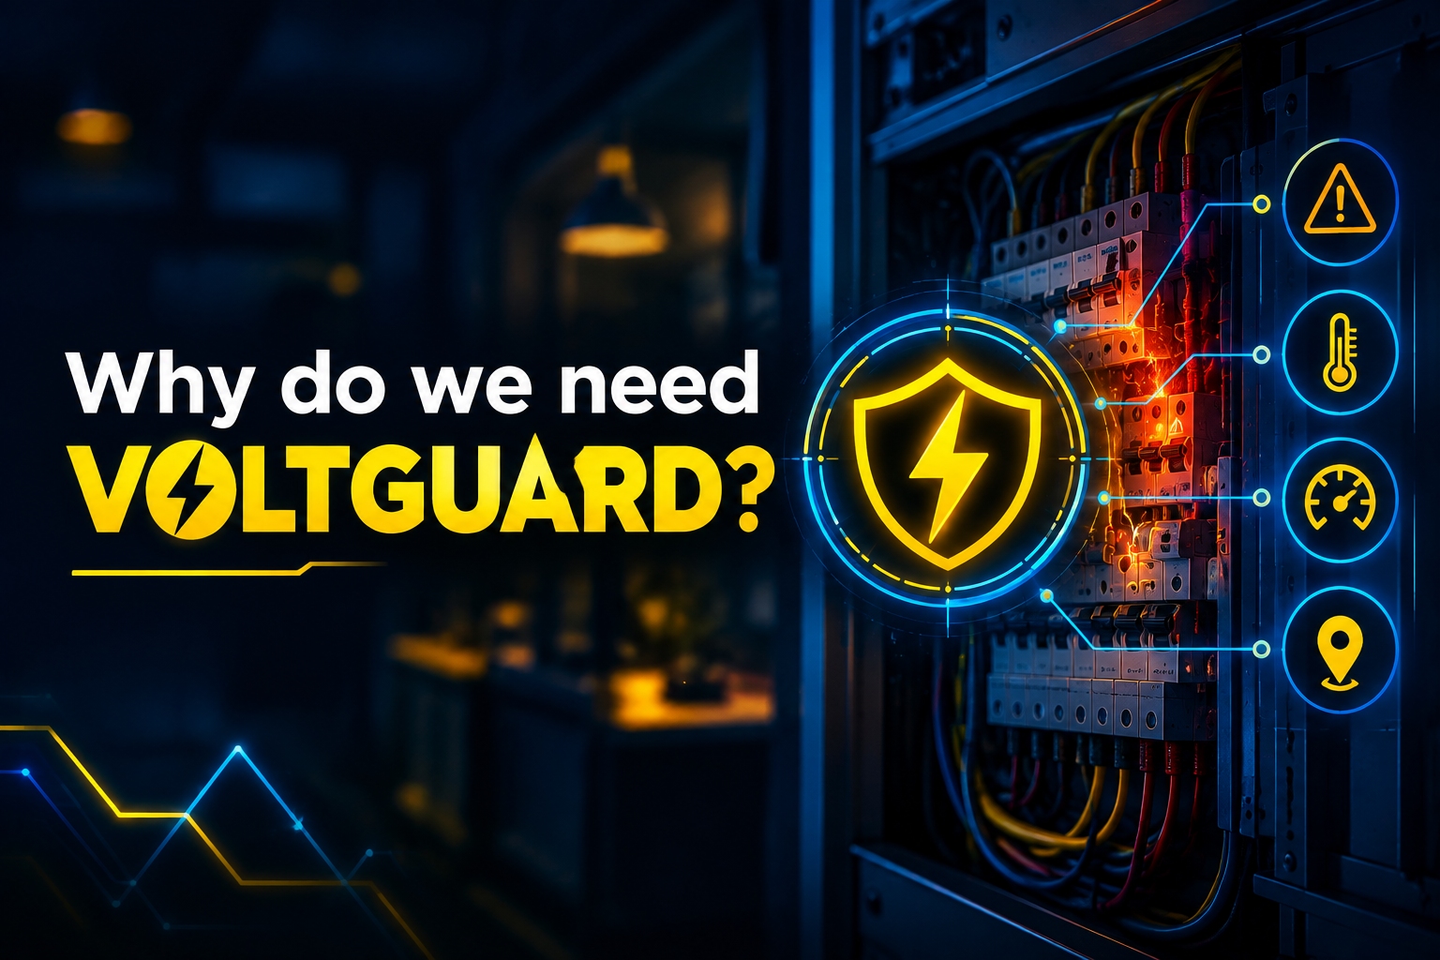

What makes our solution better
Existing solutions can protect, monitor, or alert — but our focus is to combine electrical behaviour analysis with risk localization and explainable early warning.

Slide 7
Our Solution: VOLTGUARD ⚡🛡️
VOLTGUARD is an AI-based system that continuously monitors electrical parameters and identifies which load/circuit is developing abnormal behaviour.
How it solves the problem:
1. 📡 Monitor
Continuously collect current, temperature and electrical behaviour data.
2. 🤖 Analyse
AI/ML analyses the collected data and detects abnormal patterns.
3. 📍 Localize
Identify the specific risky load/circuit instead of giving only a general fault alert.
4. ⚠️ Classify Risk
🟢 Normal → 🟡 Warning → 🔴 Critical
5. 🔔 Early Warning
Send an understandable alert with the risk level and possible reason, allowing preventive action.

Slide 8
WHAT MAKES VOLTGUARD DIFFERENT?
Existing Approach | VOLTGUARD
Detects a fault | Identifies emerging risk
General alert | Risky load/circuit localization
Single parameter focus | Multiple electrical signals
Limited explanation | Risk + possible reason
Reactive protection | Early preventive warning

Slide 9
FEASIBILITY & IMPACT
Low-cost prototype using sensors + ESP32
AI/ML-based risk analysis
Suitable for homes, colleges, shops & workshops
Early warning → preventive action
Scalable to multiple circuits/buildings

Slide 10

CONCLUSION
VOLTGUARD ⚡🛡️
Detect Early. Locate Risk. Prevent Disaster.
Our goal:
To make electrical safety smarter, earlier and more actionable.
THANK YOU

